Slide 1

Data oriented approach to C++

Slide 2
Terminology
Efficiency
How much work is required to complete a task.
Improving efficiency involves doing less work.
An efficient software system is one which does a minimum amount of work to complete a task provided.

Slide 3
Terminology
Performance
How fast a program does the work.
Improving performance involves doing the same amount of work faster.
An “performant” software system is not a term! You can never say that work cannot be done faster.
This is a hardware limited effect and may vary.

Slide 4
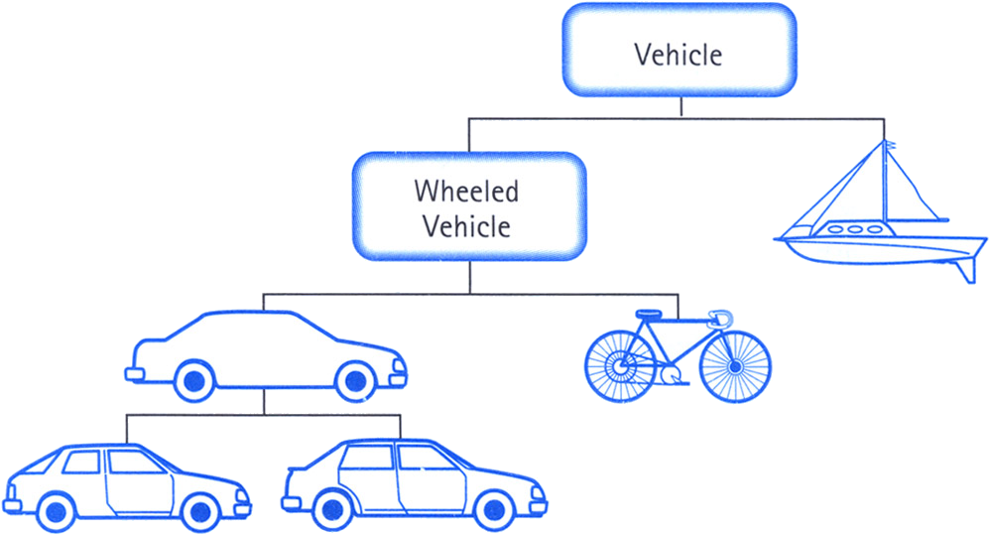
Object oriented C++ and virtual world

Slide 5
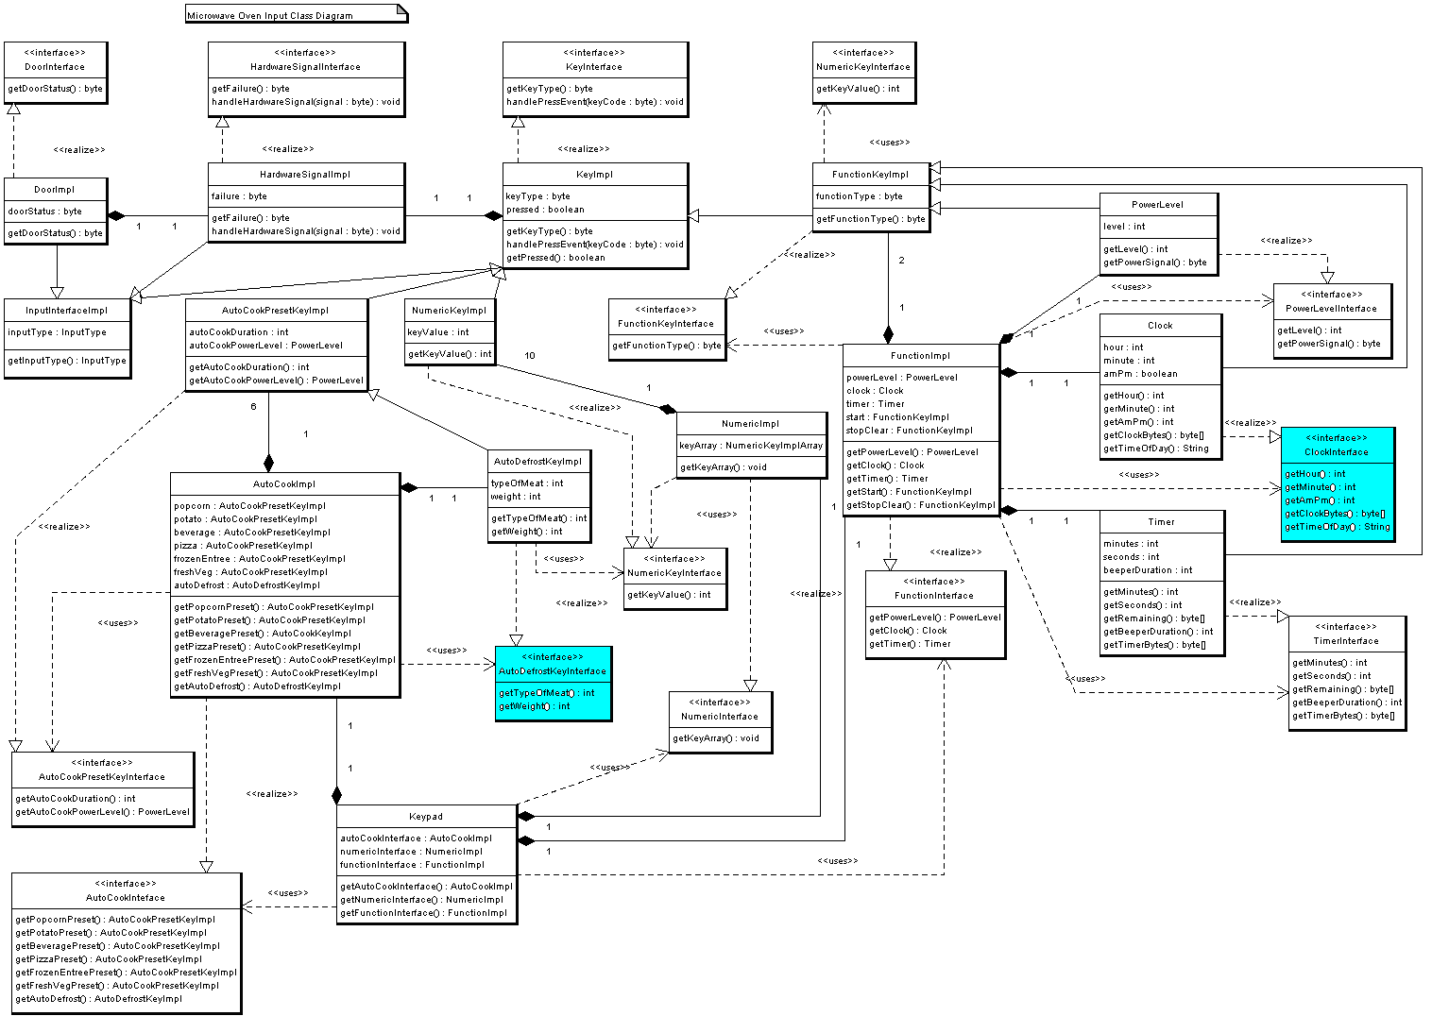
The actual world

Slide 6
What issues do arise?
Unrelated data is grouped together
Monolithic classes and structures
Code-base difficult to maintain
Poor debuggability
Poor performance

Slide 7
What happens next
Let’s build more abstractions
Let’s introduce more complexity
Let’s introduce more indirection
Let’s image that hardware is not a limit
Let’s pretend that poor performance is a
FEATURE

Slide 8


Slide 9

And the reaction from the customer is

Slide 10
Initial hypothesis
Separate unrelated data
Reduce complexity
Remove data indirection
Understand the hardware we work on
Profile and benchmark all the time

Slide 11
Which leads to the observations
Software cannot be designed around the model of the world
Resources on the target platform is the key
CPU does not respect your wishes
Working against hardware gets you
NOWHERE

Slide 12
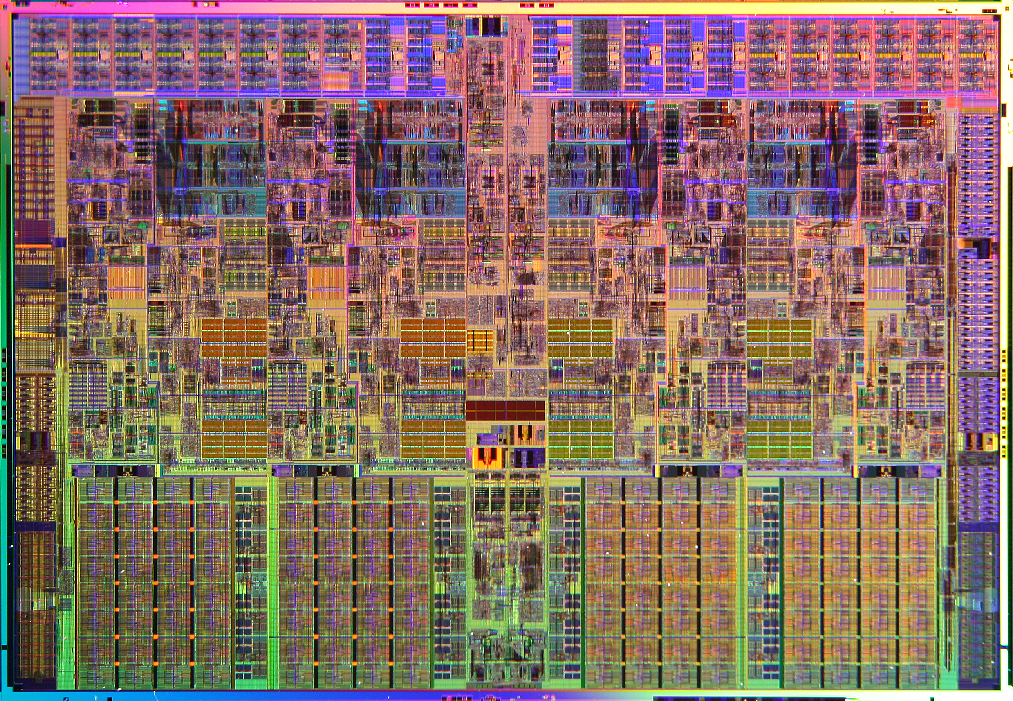

Slide 13
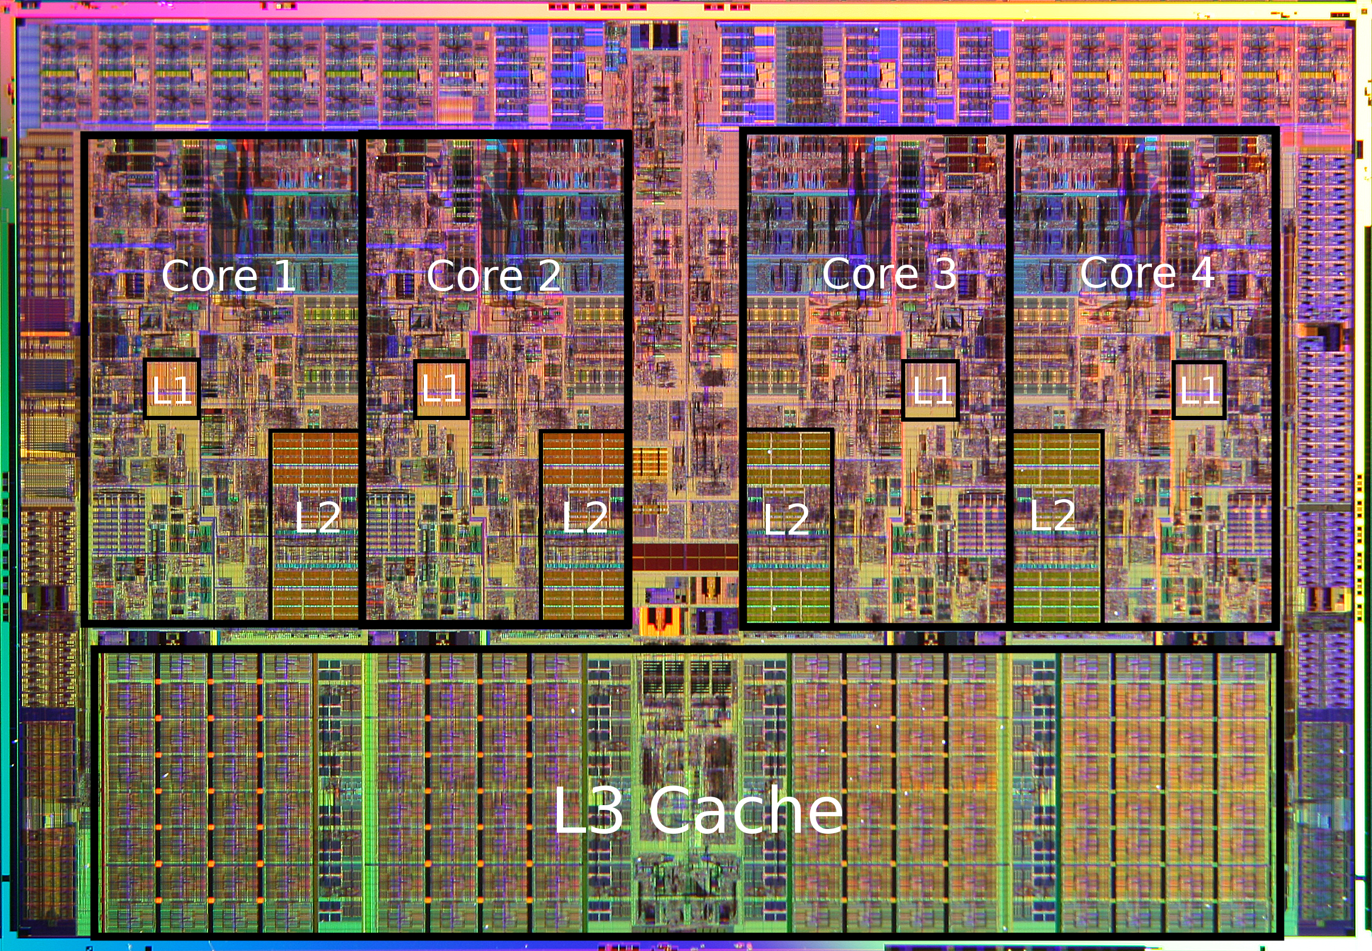

Slide 14
Access cost on X86_64
L1 cache reference 0.5 ns
Branch mispredict 5 ns
L2 cache reference 7 ns 14x L1 cache
Mutex lock/unlock 25 ns
Main memory reference 100 ns 20x L2 cache, 200x L1 cache
Compress 1K bytes with Zippy 3,000 ns 3 us
Send 1K bytes over 1 Gbps network 10,000 ns 10 us
Read 4K randomly from SSD* 150,000 ns 150 us ~1GB/sec SSD
Read 1 MB sequentially from memory 250,000 ns 250 us
Round trip within same datacenter 500,000 ns 500 us
Read 1 MB sequentially from SSD* 1,000,000 ns 1,000 us 1 ms ~1GB/sec SSD, 4X memory
By Jeff Dean @ Google

Slide 15
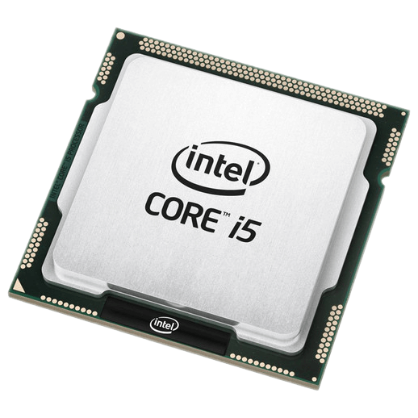
Cache miss cost
L1
L2
RAM

Slide 16
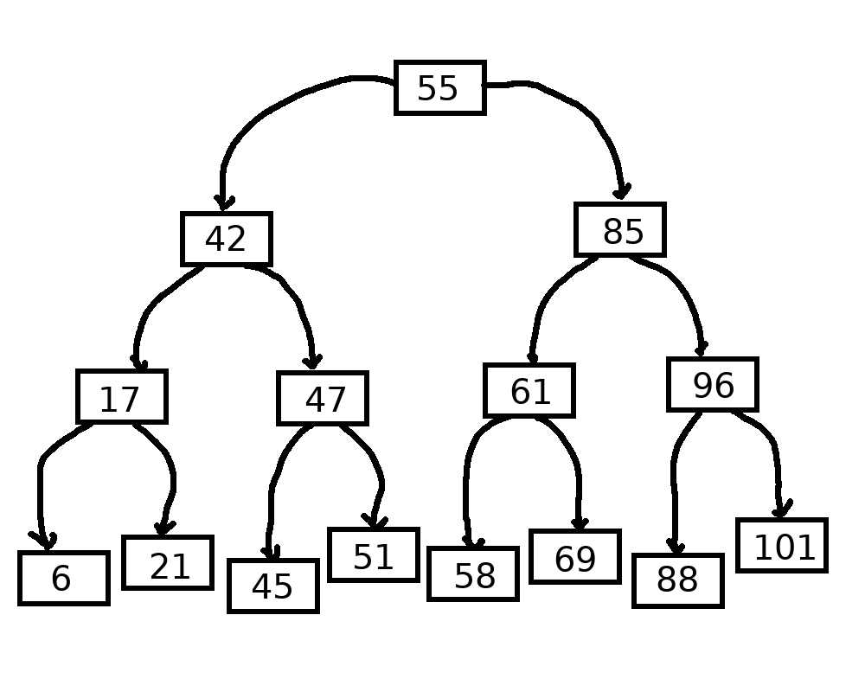
std::map

Slide 17
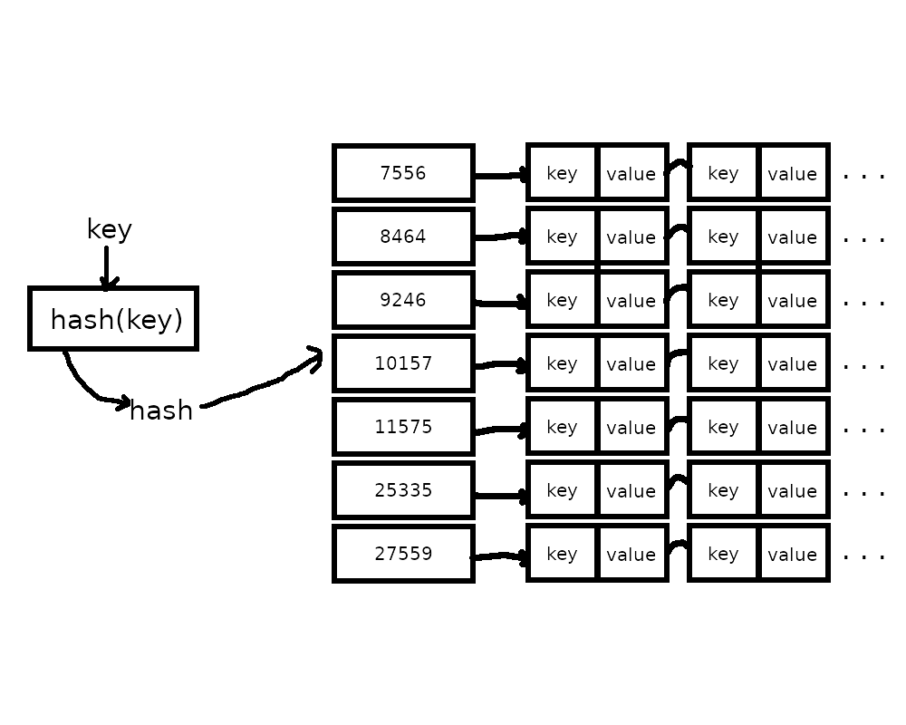
std::unordered_map

Slide 18

Let’s do it
LIVE!!!

Slide 19
Algorithms Plus Data Structures Equals Programs by Niklas Wirth
  ISBN 10: 0130224189 ISBN 13: 9780130224187
CppCon 2014: Chandler Carruth "Efficiency with Algorithms, Performance with Data Structures"
  https://www.youtube.com/watch?v=fHNmRkzxHWs
CppCon 2014: Mike Acton "Data-Oriented Design and C++"
  https://www.youtube.com/watch?v=rX0ItVEVjHc
CppCon 2015: Chandler Carruth "Tuning C++: Benchmarks, and CPUs, and Compilers! Oh My!"
  https://www.youtube.com/watch?v=nXaxk27zwlk
CppCon 2017: Chandler Carruth “Going Nowhere Faster”
  https://www.youtube.com/watch?v=2EWejmkKlxs
GDC 2015: How to Write Code the Compiler Can Actually Optimize
  https://www.youtube.com/watch?v=x61H6qEtK08

Slide 20
Questions?

